Slide 1
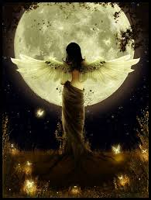
Frost Moon
Healing the metal element

Slide 2
Fall Healing
Releasing and letting go
Identification
Attachment and non attachment
Metal element
Psychology
Actions
Support

Slide 3
Five Elements
Wood – Spring Beginning expansion
Fire- Summer Maximum Expansion
Earth – Late summer Stillness
Metal – Fall Beginning contraction
Water – Winter maximum contraction
Movement, qualities, characteristics
Annual terms of biological growth

Slide 4
Metal
Dry
Weeping
Grief
Pungent
Lungs / Large intestine
Nose
Skin
Rank
Po
Righteousness

Slide 5
Lungs: The tender organ
Energy distribution
Vitality
Reactiveness
Responsiveness
Grief
Suffocation
Inspiration
Effected easily by the external environment
Receives pure energy from the heavens

Slide 6
Our fist breath is what makes us human …For no being can exist without it. The lungs are vital to the air we breathe and spirit we experience

Slide 7
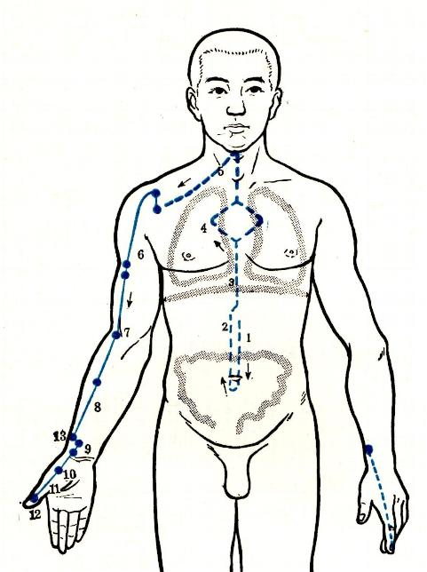
Lung Meridian

Slide 8
Large Intestine
Letting go
Release
Grief
Self – poisoning
Control
Compulsiveness

Slide 9
We need to eliminate mental and spiritual rubbish, lest our minds become toxic and constipated, unable to experience the pure and the beautiful that also surround us.

Slide 10
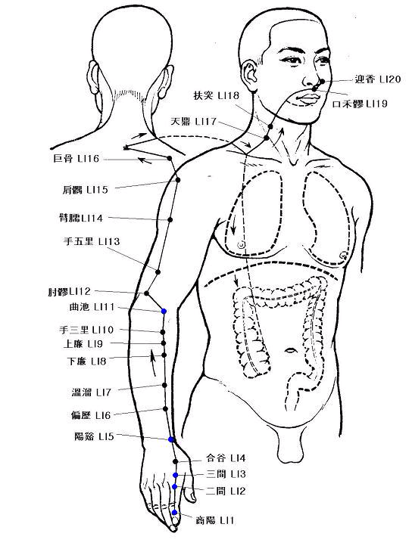
Large Intestine Meridian

Slide 11
Lung & large intestine working together
One taking in the pure and the other eliminating waste
Attachment and non attachment
Dispersing

Slide 12
Po: Shen of the lungs
Animal instinct and primary reactions to life
Directly dependent on our physical being
Knee jerk reactions and transitory feelings
Allows us to capture the fluid completeness in a single moment of inspiration and passion
When disrupted people have difficulty in appreciating moments that have passed or that cease to exist
loss or incompletion

Slide 13
Individuation
Transformation and expansion of our existing bonds (letting go and reattaching)
Adolescence loosens our family bonds and expands our external environments
Social and anti social behaviors and the experience of impermanence
Struggle in relationship to authorities and others engenders control birthing the " I AM" SPRIT
Tests and failures develop self confidence and self esteem leading to self worth.
Notes:
imbalanced, we cannot sense our value; so we compensate by seeking what we think will add to our worth: status, money, power, conquest
identify their own worth with “things” - achievements, attachments, collections, possessions, attitudes stored in the cluttered attic of the mind

Slide 14
Yin and Yang of metal
YIN responsive reactions
Yang response or surrender
Holds bonds as a conduit for growth and further development (new and old)
Mystical intertwining
Grief results when bonds are broken
Illness, pain and deterioration result when we don't allow proper grieving (loose fibers)
When we break our bonds too often we can't grow
Creates a force for release and letting go
Change in personal or intellectual preferences
Release grief to experience joy
Surrender and forgiveness
(Adolescent freedoms and challenge of convention)

Slide 15
YIN metal imbalances
Deficiency
Excess
Inability to form relationships
Difficulty producing the threads (water in metal)
Difficulty holding threads (earth in metal)
Difficulty directing threads (wood/fire in metal)
Dependence (giving or receiving)
Anxiety (power, control, avoidance, irritation)
Depression, cumulative incomplete grief
Love beyond infatuation cannot root, grow, or withstand
Domineering and possessive
Self absorbed and demanding attention
Anxiety
Conditional love

Slide 16
YANG metal imbalances
Deficient
Excess
Lack of energy
breathing shallow with little connection with the universe ( spiritual and physical )
Avoidance and caution
Limited cognition
Over reliance on authority
Clinging
The drifter
Skipping mind / sex / attention
Anxiety from blocks in wandering

Slide 17
Ideas to balance metal
Go through your closet, desk, garage, medicine cabinet - any cluttered storage area-and discard what you no longer need.
Do a mental inventory: Examine attitudes (prejudices, envies, hatreds, jealousies, resentments) stored within your psyche. Attempt to resolve the hurtful old issues, and then let them go.
For issues you cannot resolve directly with others, or for old issues with yourself, write them on paper, being as specific as possible. Then burn the paper, symbolically releasing the content.
Take time each day to breathe slowly and deeply. As you inhale the clean autumn air, feel yourself energized and purified. Feel the old negativity, impurity, and pain leave your body and psyche. Then contemplate briefly who you are without these identifications.

